Slide 1
Let’s all strive for greatness
RESEARCH CHALLENGE

Slide 2


CFA Society Czech Republic is Pleased to Bring You the CFA Institute Research Challenge
Notes:
CFA Institute is the global association of investment professionals that sets the standard for professional excellence and credentials. The organization is a champion for ethical behavior in investment markets and a respected source of knowledge in the global financial community. The end goal: to create an environment where investors’ interests come first, markets function at their best, and economies grow. CFA Institute has more than 113,000 members in 140 countries and territories, including more than 100,000 CFA charterholders, and 144 member societies.
Mission:
“To lead the investment profession globally by promoting the highest standards of ethics, education, and professional excellence for the ultimate benefit of society.”
CFA Institute writes and administers the CFA Examination, the gold standard in investment credentialing, and is a leading voice on issues of fairness, efficiency, and investor protection for global capital markets.
CFA Society Czech Republic is one in this network promoting the lifelong learning opportunities for the more than 160 members and 1000 candidates in [Society Name] and the surrounding area.
CFA Society of [Society Name] is responsible for bringing the CFA Institute Research Challenge to your university.

Slide 3
CFA Institute Research Challenge
Worldwide intercollegiate competition between teams of students
Unique educational opportunity to apply what you have learned in the classroom to real-world practice in equity research
Organized by local CFA Society volunteers
Winners from the local competitions advance to one of the three regional competitions, culminating in a global final
Notes:
A local-level Research Challenge is a local, intercollegiate competition sponsored by CFA Institute volunteers – usually through one of CFA Institute’s 140+ member societies. Local competitions invite at least three different universities, each sponsoring a team of 3 to 5 students, to participate.
This competition is unique because it promotes best practices, research skills, analysis, report writing, and presentation skills in action. What also makes it unique is what it is NOT. The competition is not based on the performance of a particular stock or portfolio and therefore doesn’t promote short-termism.
It does promote how to conduct research ethically, how to analyze the relevant data and develop a recommendation and how to present and defend that recommendation in a professional manner

Slide 4
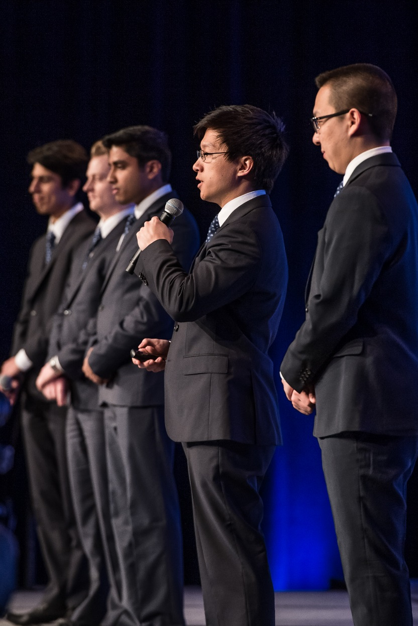
How it Works
Local CFA Society volunteers work in conjunction with participating local universities to assemble teams of 3–5 business and finance students
Each team works directly with a mentor to research and prepare an equity research report on a publicly traded company
Team findings are locally evaluated by high-profile panels of heads of research, portfolio managers, and chief investment officers from some of the world’s top firms
Local champions advance to regional competitions in the Americas, Asia Pacific, and EMEA, and then to the global final
Notes:
A local-level Research Challenge is a local, intercollegiate competition sponsored by CFA Institute volunteers – usually through one of CFA Institute’s 140+ member societies. Local competitions invite at least three different universities, each sponsoring a team of 3 to 5 students, to participate. Some local competitions allow two teams per university.
This competition is unique because it promotes best practices, research skills, analysis, report writing, and presentation skills in action. What also makes it unique is what it is NOT. The competition is not based on the performance of a particular stock or portfolio and therefore doesn’t promote short-termism.
It does promote how to conduct research ethically, how to analyze the relevant data and develop a recommendation and how to present and defend that recommendation in a professional manner.

Slide 5

Benefits
Real-life learning experience as an Equity Analyst
Get in-depth training in company analysis and presentation skills
Develop your resume/CV
Get hands-on mentoring
Network with professionals and peers to make inroads within the industry
Notes:
A local-level Research Challenge is a local, intercollegiate competition sponsored by CFA Institute volunteers – usually through one of CFA Institute’s 140+ member societies. Local competitions invite at least three different universities, each sponsoring a team of 3 to 5 students, to participate. Some local competitions allow two teams per university.
This competition is unique because it promotes best practices, research skills, analysis, report writing, and presentation skills in action. What also makes it unique is what it is NOT. The competition is not based on the performance of a particular stock or portfolio and therefore doesn’t promote short-termism.
It does promote how to conduct research ethically, how to analyze the relevant data and develop a recommendation and how to present and defend that recommendation in a professional manner.

Slide 6
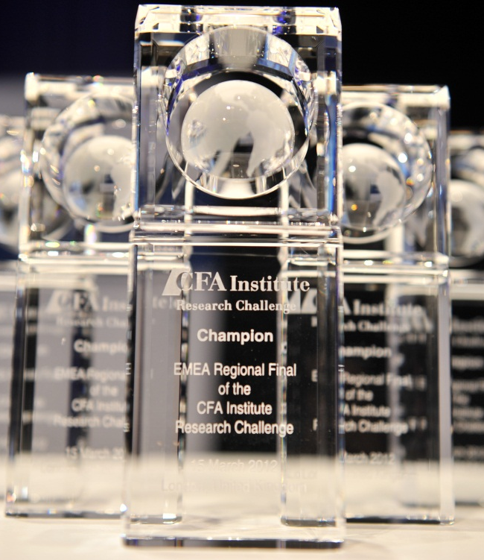

COMPETITION TIMELINE
10 October (TBC) | Kick-Off
Next days | University to Nominate Teams
22 October | Register with CFA Institute
24 October | Company Presentation, Prague/livestream
Week of 18 Nov (TBC) | Analyst Q&A Calls
9 December | 1st Draft Report Due to Mentors
23 December 23:59 | Final Report Due
Interim | Report Grading
14 January | Teams Announcement
5 February (TBC) | Local Final Presentations
8-9 April | Subregional round, EMEA
10-11 April | Regional Semifinals/Finals, EMEA
May (TBA) | Global Final (Chicago, USA)
11
Notes:
It is extremely important that all students register for the competition on CFA Institute’s website. Once the student is registered, he/she will receive a complimentary electronic copy of Equity Asset Valuation (CFA Institute Investment Series). This registration will also ensure that each student receives a certificate acknowledging his/her participation in the competition.

Slide 7
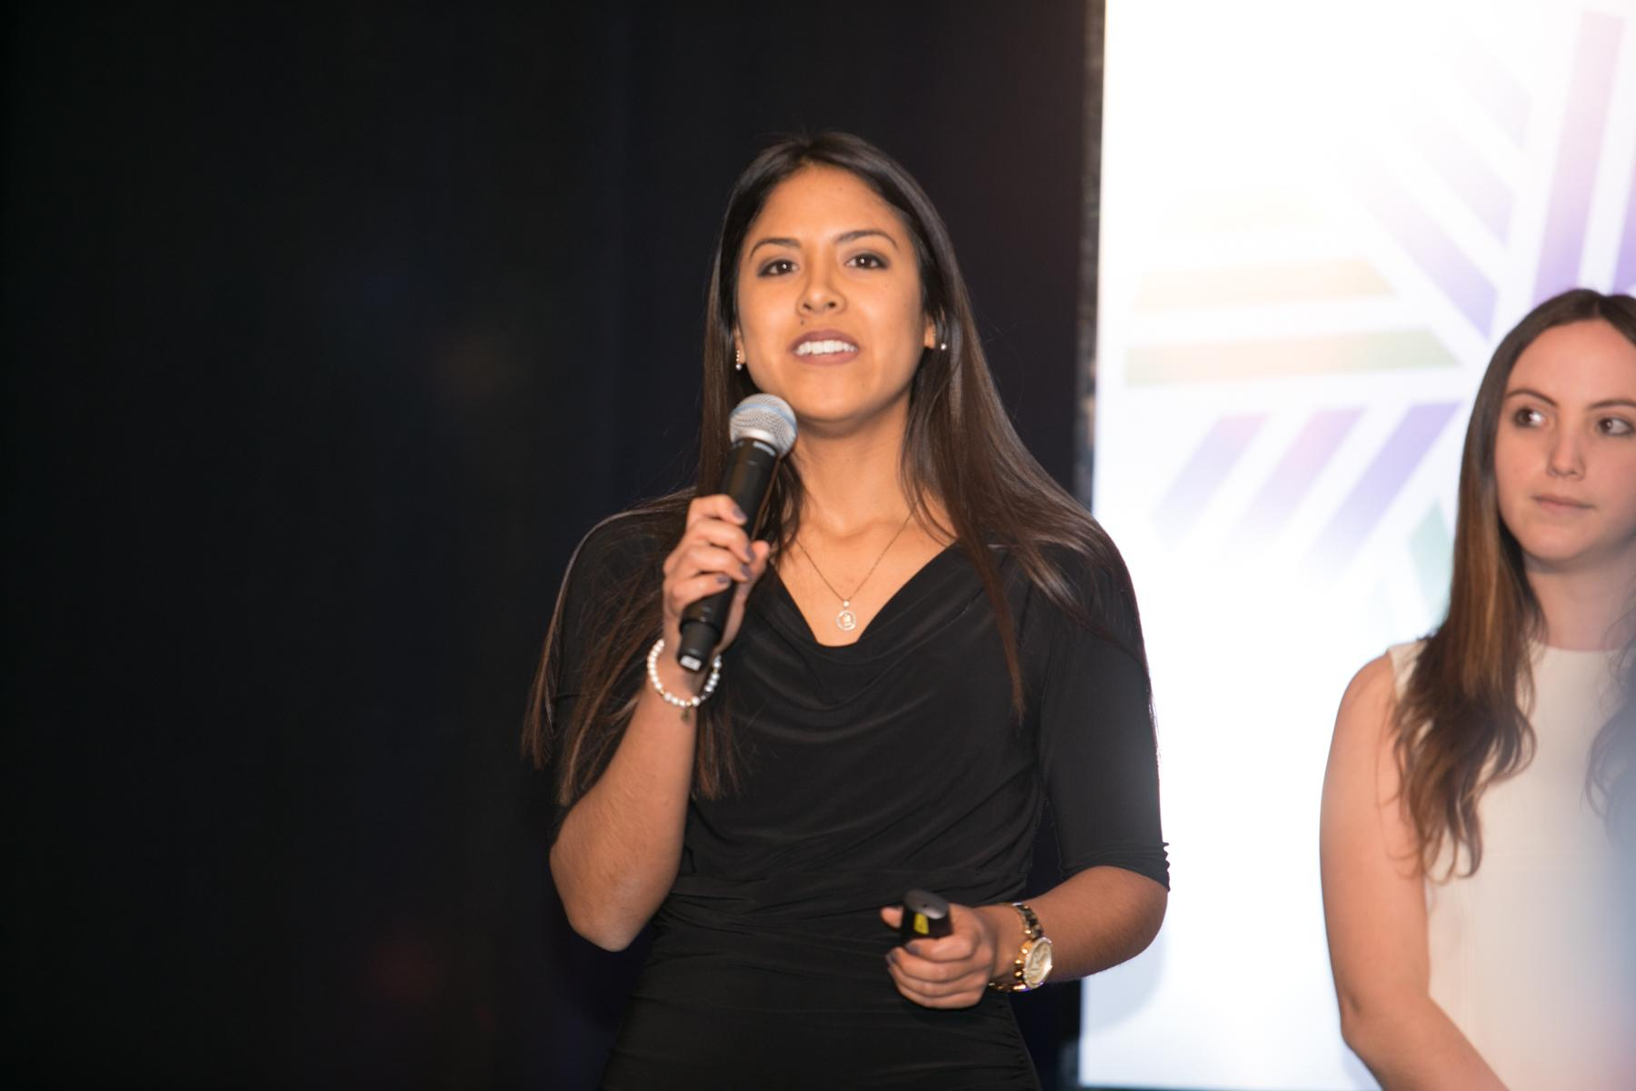
Up for the Challenge?
Visit the CFA Institute Research Challenge website: www.cfainstitute.org/researchchallenge
Register for the competition
  Peruse educational materials selected specifically for participants
  Watch videos of past presentations
  View past reports from winning teams
Students MUST register in their account via the invitation link they receive from CFA Institute (will be distributed via Faculty Advisors).

Slide 8
Questions?
Notes:
To learn more about the charter and CFA Institute, I encourage you to visit our website for more information or to register.
I am also happy to answer any questions that you might have.
Thank you for your time.

